Slide 1
Maru Batting Center
(Part 1)

Slide 2
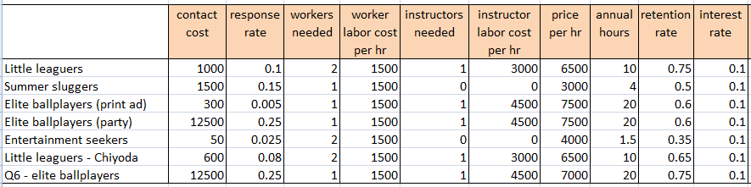
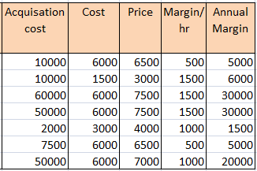
Table 1

Slide 3
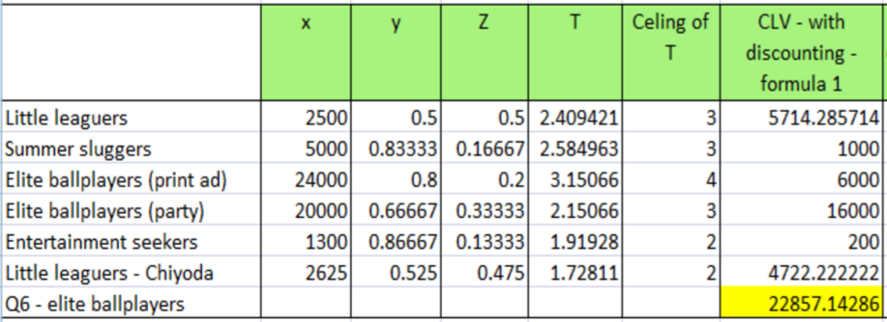
Table 2

Slide 4
Q 1. Acquisition cost to MBC
Acquisition Cost = Total cost/ Response rate
As shown in the table-1, acquisition cost for the Elite Ballplayers is the highest. AC for Elite ballplayers with print Ads and with Gala invites is ¥60,000 and ¥50,000 respectively. On the other hand, Entertainment Seekers have the lowest acquisition cost, ¥2,000. AC for Little Leaguers and Summer Sluggers is equal, ¥10,000 per customer.

Slide 5
Q 2. Breakeven to MBC (without discounting cash flows)
Breakeven is when M*(1-r^t)/(1-r)>=AC
As shown in the table-1 and table-2,
Little Leaguer: M = 5000, r=0.75, AC=10000.
Using above formula, t = 2.4
3. Elite Ballplayers (Print Ad) : M= 30000, r=0.6, AC=60000
Using above formula, t = 3.15
2. Summer Sluggers: M= 6000, r=0.5, AC=10000
Using above formula, t = 2.5
4. Elite Ballplayers(Gala Invite): M= 30000, r=0.6,AC=50000
Using above formula, t = 2.15
5. Entertainment Seekers : M= 1500, r=0.35, AC=2000
Using above formula, t = 1.9
This calculation suggest that, breakeven for the Entertainment Seekers is achieved the earliest, just within first 2 years of operation. Little leaguers, Summer Sluggers and Elite Ballplayers(with Gals invites) segments take almost same time, between year 2 and 3, to breakeven. Elite Ballplayers with Print Ads take more than 3 years to breakeven which is the longest time compared to any other segment.

Slide 6
Q 3. Life time value to MBC for all customer segment
Customer Lifetime Value (CLV) = Sum of future cash flows from a customer
As shown in the table-2, CLV formula-1 is applicable to the MBC case if they received the first payment as and when the customer booked the facility for the first time. However, it is not clear from the case when the payments are received. In the most likely scenario, payments are received throughout the year whenever customers booked their appointment (at least 24 hrs in advance). Going with the same assumption, we have used CLV formula-1 for MBC.
CLV for different segments:
Little Leaguer: ¥5714
Summer Sluggers: ¥1000
Elite Ballplayers(Print Ads): ¥6000
Elite Ballplayers(Gala Invites): ¥16000
Entertainment Seekers: ¥200
Looking at the CLV for Elite ballplayers with Gala invites, MBC should go ahead and send the invites. CLV from this segment is the highest compared to other segments.

Slide 7
Q 4. Which is the most attractive segment for MBC to target?
As shown in the table-1 and table-2, Elite Ballplayers with Gala invites is the most attractive segment for MBC. This segment has the highest margins, the highest customer lifetime value and the second quickest break even point compared to any other segment.
Elite Ballplayers with Gala invites
Margins/hr : ¥1500
Annual Margins: ¥30000
Break even: 2.1 years
CLV: ¥16000

Slide 8
Q 5. Should MBC pursue Chiyoda ward or Minato ward?
Q 6. Should MBC offer the promotion?
Table-2 shows the CLV for Chiyoda ward sponsorship. CLV for Chiyoda ward is ¥4722, which is definitely better than the CLV of Minato ward. Also, the break even point for Little Leaguers with Chiyoda sponsorship is earlier than that of Minato ward. Breakeven point for Chiyado ward is 1.7 years.
We suggest that MBC should pursue Chiyoda sponsorship.
As shown in the table-1 and table-2, Elite Ballplayers who are offered this promotion have the highest CLV, ¥22,857. Although, this promotion will decrease the hourly price of MBC, the increase in the retention rate makes this segment very attractive. With this new promotion MBC can achieve substantially higher customer lifetime value.
We suggest that MBC should offer this promotion to its Elite Ballplayer.

Slide 9
Q 7. Bonus Challenge
contact cost | response rate | workers needed | worker labor cost per hr | instructors needed | instructor labor cost per hr | price per hr | annual hours | retention rate
12500 | 0.29 | 1 | 1500 | 1 | 4500 | 7500 | 20 | 0.6
interest rate | Acquisition cost | Cost | Margin/hr | Annual Margin | CLV - with discounting
0.1 | [(12500/0.29)+10000] =53103.4483 | 6000 | 1500 | 30000 | 12896.5517
As the CLV is less than ¥22,857, and even less than ¥16,000. We prefer not going with this promotion.

Slide 10
Sensitivity Analysis
Test 5 scenarios for each variable
when ac=c(50000,50000*0.8,50000*0.9,50000*1.1,50000*1.2)
CLV_expected: 16000 26000 21000 11000 6000
when am=c(30000,30000*0.8,30000*0.9,30000*1.1,30000*1.2)
CLV_expected: 16000 2800 9400 22600 29200
when rr=c(0.6,0.6*0.8,0.6*0.9,0.6*1.1,0.6*1.2)
CLV_expected: 16000.000 3225.806 8928.571 25000.000 36842.105
2. Calculate CLV for all combinations:
1 50000 30000 0.60
2 40000 30000 0.60
… ...
124 55000 36000 0.72
125 60000 36000 0.72

Slide 11
3. How often the CLV is negative/lower than 5714 (less than Little Leaguers)
There are 19 negative CLVs, 19/125=0.152
There are 32 combinations have CLV lower than 5714 , 32/125=0.256
In part 1 we just did analysis with specific number. It could be used for CLV comparison among different customer segments, but we are not sure about the possibility of the conclusion.With sensitivity analysis, we have 75% confidence that Elite-ballplayers could get CLV more than 5714 and 85% confidence that the CLV is positive. With sensitivity analysis we have more confidence about the comparison.

Slide 12
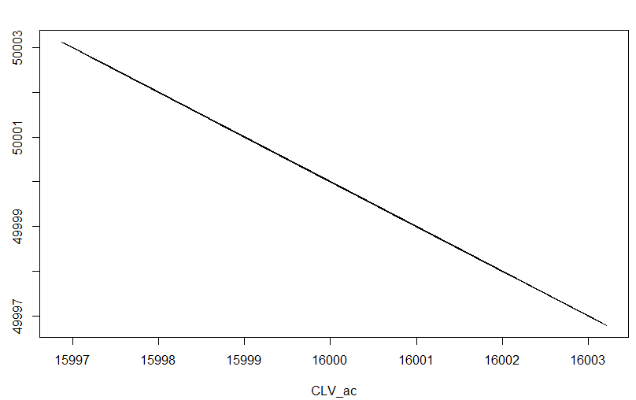
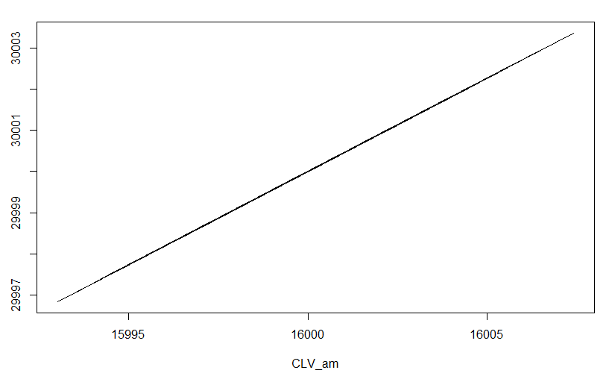
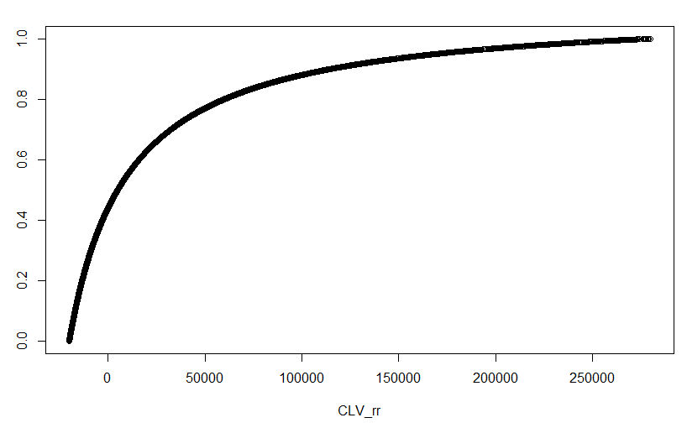
ac and am have linear relationship with CLV, while rr play an exponential effect on CLV. At this point, rr is playing an more important role at the range when its slope is sharp. When the retention rate is lower than 0.6, MBC should focus on increase retention rate. When retention rate is higher than 0.6, they can focus on lowering ac and increasing am.

